Slide 1
Image Captioning
Using Deep learning
For Visually Impaired
Team members:
Rohit Kumar | 01FE18BCS178
Aditya Mutagi | 01FE18BCS019
Shashidhar M | 01FE18BCS199
Akash D H | 01FE18BCS021
Raghavendra B | 01FE18BSC163
Senior Design Project Team - D 24
Guide: Dr. S.G. Totad

Slide 2
Introduction

Slide 3
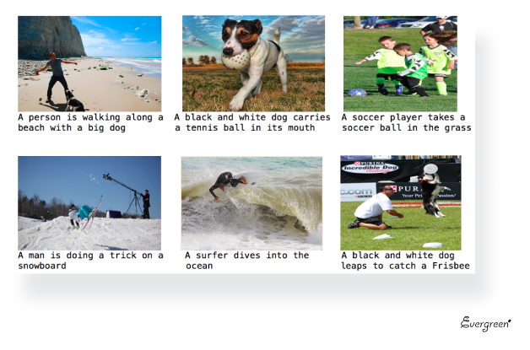
Problem statement
1.Our aim to build an application to be able to interpret images and give a comprehensible text about the given image using deep learning frameworks such as CNN and LSTM deep neural networks.
2.The purpose of this project is to provide an application for visually impaired people to be able to understand and interpret an image to some satisfactory degree and improve their experience and involvement on the internet.

Slide 4
Objectives
Recognize the objects in image using CNN and prepare a feature vector.
Generate a brief sentence using the feature vector.
Convert the caption sentence to speech for better reach.

Slide 5
Motivation
Interpreting images is a daunting task for visually impaired. Their inability to comprehend images hinders their overall experience of internet browsing. Many successful models have been built for text-to-speech, but not for describing images. Normal screen readers that are available for visually impaired people are implemented using the text-to-speech APIs available.
So, a person who is relying on these applications might lose the context since images cannot be read out loud. There is a need to fill in that contextual gap that exists between images and text-to-speech screen readers.

Slide 6
Literature Survey

Slide 7
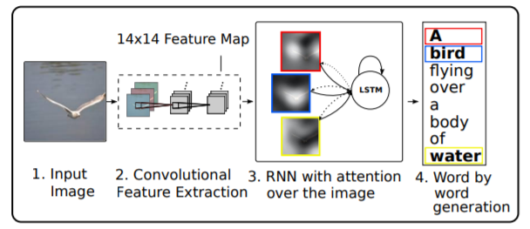
Base Paper – ‘Show, Attend, and Tell: Neural Image Caption Generation with Visual Attention’ by Kelvin Xu and his team
They introduced an attention-based model that automatically learns to describe the content of images.
To train the model, standard backpropagation techniques are used. they validate the use of attention with state-of-the-art performance on three benchmark datasets: Flickr 8k, Flickr30k, and MS COCO.
The model brings together convolutional neural networks, recurrent neural networks and works in modeling attention mechanisms.
https://arxiv.org/pdf/1502.03044.pdf

Slide 8
Reference Papers
Sr. No | Paper | Publication | Inferences
1 | ‘Image Captioning for Ambient Awareness on a Sidewalk’ by Faruk Ahmed, Md Sultan Mahmud, Rakib Al-Fahad, Shahinur Alam, and Mohammed Yeasin | 2018 1st International Conference on Data Intelligence and Security (ICDIS) | 1.The design and implementation of a system embedded in an RPi3 is part of the experiment. 2.They have considered two types of inputs: voice command and button press. A user can choose to have spoken feedback, haptic feedback, or a certain tone for obstacles
2 | Image Captioning’ by Vikram Mullachery, Vishal Motwani. | Mullachery, V., & Motwani, V. (2018). Image Captioning. ArXiv, abs/1805.09137. | 1.They used three different datasets to train and evaluate their data models MSCOCO, Flickr30k and Flickr 8k. 2.They used the baseline model designed by A.Karpathy and improve upon that model by increasing the RNN layers and using ResNet in lieu of VGGNet. 3.This model uses 16 layers VGGnet for embedding image features and single layer RNN constituted of LSTM.They have attempted three different types of improvisation over the baseline model. Performed further training of the model on Flickr30k and Flickr 8k and initialized weights of the model with the baseline model. Increasing the number of hidden layers in the RNN over the baseline model Used ResNet in place of VGGNet

Slide 9
Reference Papers
Sr. No | Paper | Publication | Inferences
3 | ‘Image Captioning using Deep Learning: A Systematic Literature Review’ by Murk Chohan, Adil Khan, Muhammad Saleem Mahar, Saif Hassan, Abdul Ghafoor, Mehmood Khan’ | Article Published in International Journal of Advanced Computer Science and Applications(IJACSA), Volume 11 Issue 5, 2020 | In this study they have found that CNN is used to understand image contents and find out objects in an image while RNN or LSTM is used for language generation It was also found that LSTM with CNN has outperformed RNN with CNN. The purpose of this Systematic Literature Review is to study all newest Articles from 2017 to 2019 to find different methods to achieve auto image captioning in different domains. what different datasets are used to achieve the task In which different practical domains this task is used. which technique Outperforms others and finally attains to describe the technicalities behind different networks, methods and evaluation matrices
4 | Image Caption Generator Using Deep Learning by B.Krishnakumar,K.Kous alya, S.Gokul,R.Karthikeyan, D.Kaviyarasu | (IJAST)Vol.29 NO.3s(2020). | Proposed Model successfully trained to generate captions of images using CNN technique, model is depends on data and used small data set.The model generate caption by using Keras Framework used in Jupyter notebook and also conclude keras has strong support for multiple GPU’s.

Slide 10
Previous Implementations
CNN-LSTM Architecture and Image Captioning
INSIGHTS
These models have enormous potential and are being increasingly used for many sophisticated tasks such as text classification, video conversion, and so on
It allows us to use state of the art neural models for NLP tasks such as the transformer for sequential image and video data.
https://medium.com/analytics-vidhya/cnn-lstm-architecture-and-image-captioning-2351fc18e8d7#:~:text=They%20have%20proven%20so%20effective,work%20with%20sequence%20prediction%20problems.

Slide 11
Previous Implementations
Pytorch Image Captioning
In this image captioning system works and implemented from scratch.
Caption dataset Flickr8k is used to train the model.
INSIGHTS: There are multiple ways to improve the model: train a larger model (the one used is relatively small), train for longer and improve the model by adding attention similar to this paper.
https://www.youtube.com/watch?v=y2BaTt1fxJU

Slide 12
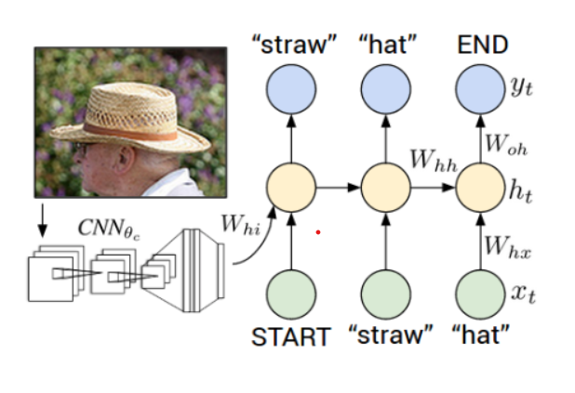
Previous Implementations
Image Captioning in Deep Learning
They have used an flickr 30k and coco dataset.
The Encoder used is CNN and RNN is used as a decoder.
https://towardsdatascience.com/image-captioning-in-deep-learning-9cd23fb4d8d2

Slide 13
Real Time Implementations
‘Microsoft’ has built a model via the Azure Cognitive Services Computer Vision offering, which is part of Azure AI, enabling developers to use this capability to improve accessibility in their own services.
‘Google’ has released its “Show and Tell” image captioning algorithm to developers, who can train it to recognize objects in photos.

Slide 14
Problem Formulation
Data Understanding: Load the data and understand the representation.
Data preprocessing: In this step, we will process both images & captions to the desired format.
Train/Test Split: Combine both images & captions to create the train & test dataset.
Model-Building: Objects are detected from the image with the help of CNN then by y using LSTM, sentences are generated. Each predicted word is employed to get subsequent words. Using these words, appropriate sentence is formed with the help of Optimal beam search. Here, SoftMax function will be used for prediction of word.
Model Evaluation: Evaluate the models using BLEU score.

Slide 15
Problem Analysis

Slide 16
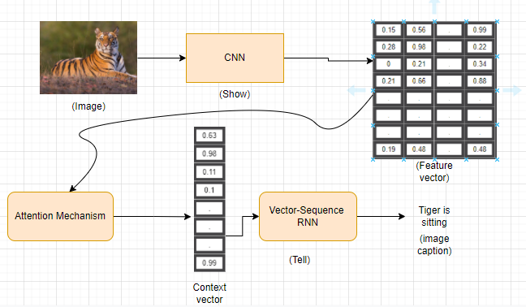
Architecture Diagram

Slide 17
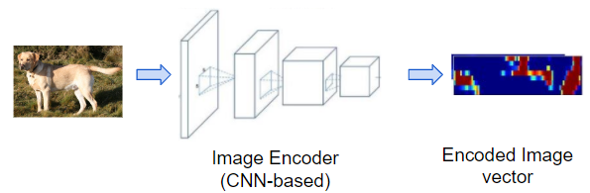
Architecture Diagram
1.Image Feature Encoder

Slide 18
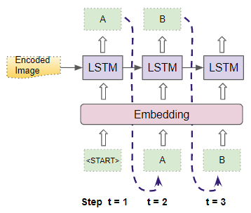
Architecture Diagram
2.Sequence Decoder

Slide 19
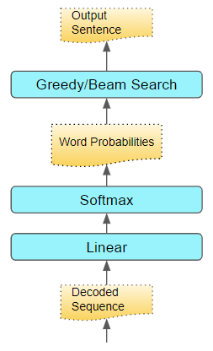
Architecture Diagram
3. Sentence Generator

Slide 20
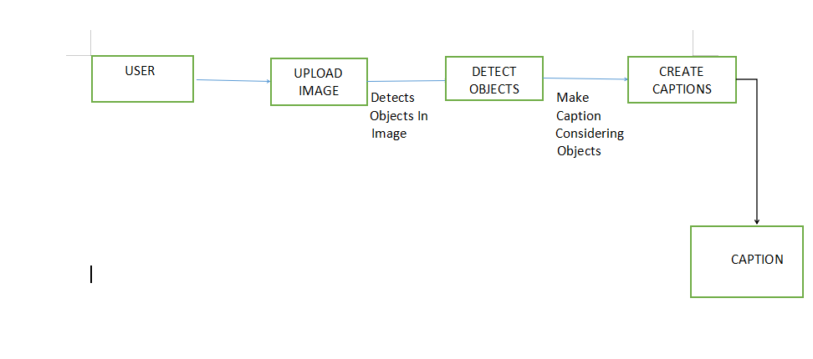
Data Flow Diagram
DFD LEVEL 1

Slide 21
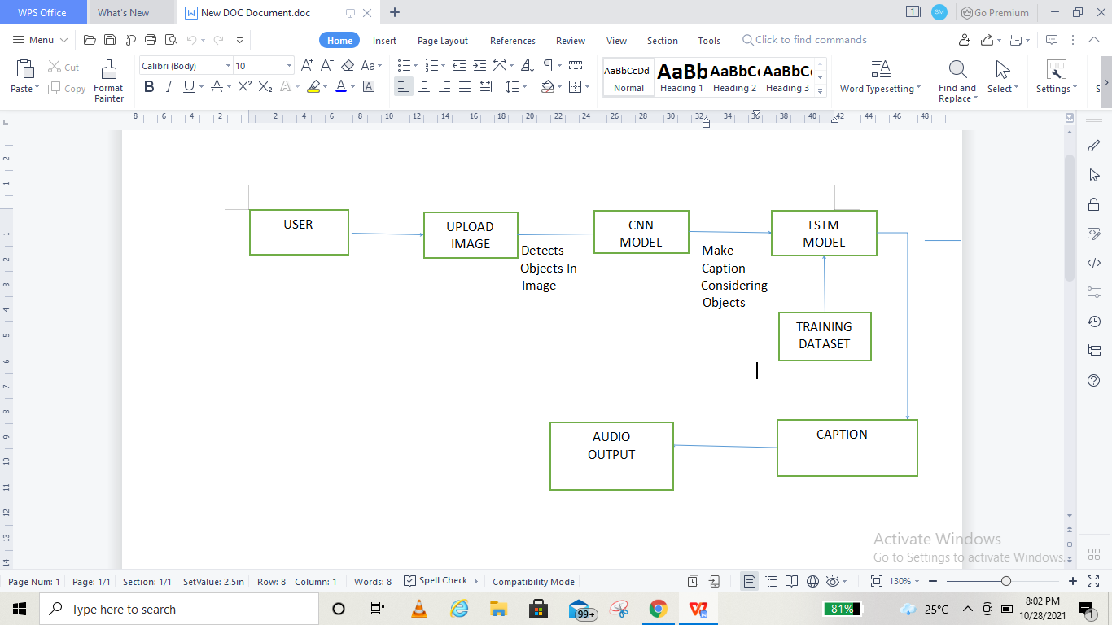
Data Flow Diagram
DFD LEVEL 2

Slide 22
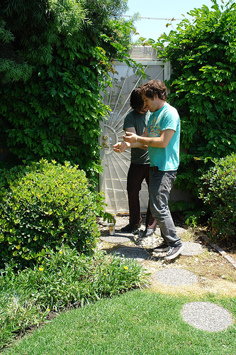
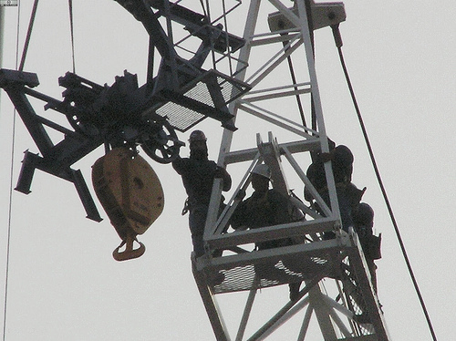
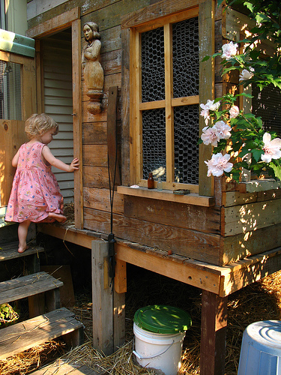
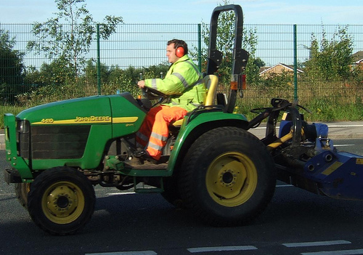
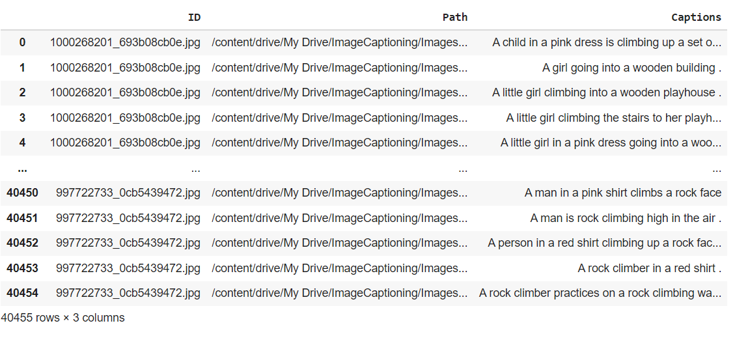
Dataset
Flicker 30k dataset will be used for training the model that has 31000 images with 5 captions for each image in a .csv format.

Slide 23
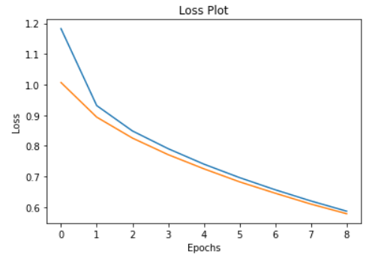
Result
The epoch vs test loss plot.
The loss is decreasing with increasing the epoch value and getting almost constant after epoch = 9

Slide 24
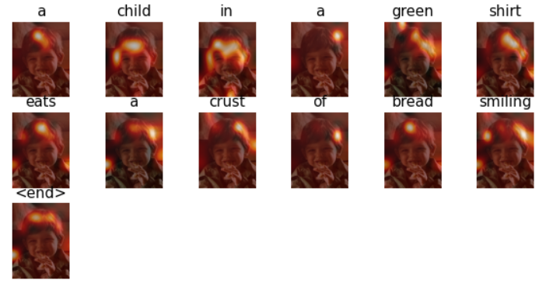
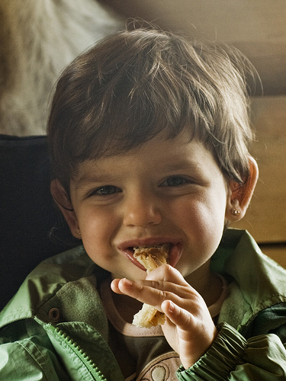
Result
Test Cases 1
The Real Caption: “a little child in a green shirt eats a crust of bread smiling.”
Predicted Caption: “a child in a green shirt eats a crust of bread smiling.”
Blue Score of the image caption is : 87.72279297934199

Slide 25
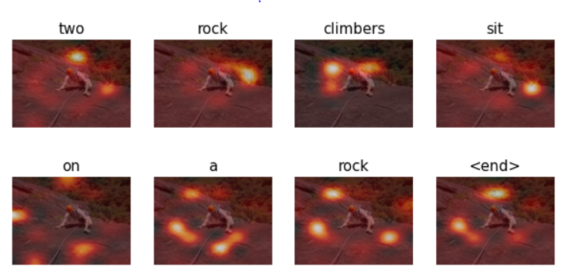
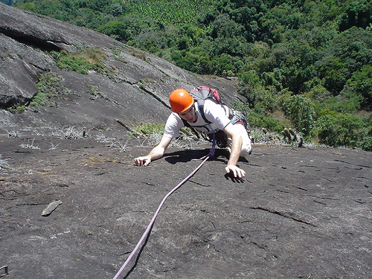
Result
Test Cases 2
The Real Caption: “a gentleman is rock climbing.”
Predicted Caption: “a rock climbers sit on a rock.”
Blue Score of the image caption is : 53.45224838248488

Slide 26
References

Slide 27
‘Image Captioning for Ambient Awareness on a Sidewalk’ by Faruk Ahmed, Md Sultan Mahmud, Rakib Al-Fahad, Shahinur Alam, and Mohammed Yeasin.
O. Vinyals, A. Toshev, S. Bengio and D. Erhan,"A Neural Image Caption Generator," CVPR 2015 Open Access Repository, vol. Xiv, 17 November 2014.
S. Yan, F. wu, J. Smith and W. Lu,"Image Captioning via a Hierarchical Attention Mechanism and Policy Gradient Optimization," LATEX CLASS FILES, vol. 14, 11 January 2019.
‘Image Captioning’ by Vikram Mullachery, Vishal Motwani.
‘Show, Attend and Tell: Neural Image Caption Generation with Visual Attention’ by Kelvin Xu and his team
J. Hessel, N. Savva and M. J. Wilber, "Image Representations and New Domains in Neural Image Captioning," ACL Anthology, vol. Proceedings of the Fourth Workshop on Vision and Language, p. 29–39, 18 September 2015
‘Image Captioning using Deep Learning: A Systematic Literature Review’ by Murk Chohan, Adil Khan, Muhammad Saleem Mahar, Saif Hassan, Abdul Ghafoor, Mehmood Khan
‘Image Captioning using Deep Neural Architectures’ by Parth Shah, Vishvajit Bakrola, Supriya Pati

Slide 28
Thank You

